Slide 1

2020
Lab 4: Data Preparation- NumPy Library
Dr. Mohammed Al-Sarem Taibah University, Information System
Department 2/15/2020

Slide 2
Lab 4: Data Preparation- NumPy Library
Lab Objectives:
Data mining tasks aim at extracting hidden information from the data. According to CRISP-DM, this process goes through well-defined steps. Data preparation is the most time-consuming and labor-intensive task. In this lab you will first get familiar with NumPy library and it functionalities and then get used to load dataset into Python Jupyter from scratch, including.
How to load a CSV file?
How to do basic statistical analysis?
Methodology
In this lab we will use the Iris Flower Species Dataset. This dataset involves the prediction of iris flower species. Your task till now is to download the dataset and
save it into your current working directory with the filename iris.csv (details how to download the dataset and where you find it will be discussed throughout the lab).
In class task:
At the end of this lab, the student will be able to:
Explore Numpy library and its functionality
Load dataset to Python Jupyter.
Get some basic statistical analysis using numpy methods
home task:
References:
CSV File Reading and Writing, The Python Standard Library https://docs.python.org/2/library/csv.html
CSV file format in RFC 4180: Common Format and MIME Type for Comma-Separated Values (CSV) https://tools.ietf.org/html/rfc4180
NumPy library: https://numpy.org/

Slide 3

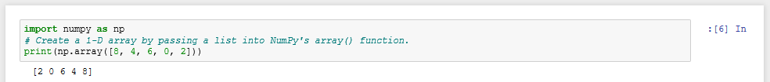
Lab 4: Data Preparation- NumPy Library
This tutorial is divided into 2 parts:
Exploring briefly the NumPy library functionality.
Working on the dataset.
NumPy Library
NumPy is the fundamental package for scientific computing with Python. It contains among other things:
a powerful N-dimensional array object
sophisticated (broadcasting) functions
useful linear algebra, Fourier transform, and random number capabilities
Besides its obvious scientific uses, NumPy can also be used as an efficient multi-dimensional container of generic data. Arbitrary data-types can be defined. This allows NumPy to seamlessly and speedily integrate with a wide variety of databases.
Getting Started
NumPy package is installed by default when you download anaconda. In case that is not properly installed, we strongly recommend using a scientific Python distribution.
To check either the package is installed, lunch your Jupyter and write the following code:
It is expected to have the following:
Once, you get a result like the above, it means that the NumPy Package is properly installed and you can move ahead in reading this tutorial.
1.1. Arrays
In many algorithms, data can be represented mathematically as a vector or a matrix. Conceptually, a vector is just a list of numbers and a matrix is a two-dimensional list of numbers (a list of lists). However, even basic linear algebra operations like matrix multiplication are cumbersome to implement and slow to execute when data is stored this way. The NumPy module1 offers a much better solution. The basic object in NumPy is the array, which is conceptually similar to a matrix. The NumPy array class is called ndarray (for “n-dimensional array”). The simplest way to explicitly create a 1-D ndarray is to define a list, then cast that list as an ndarray with NumPy’s array() function.
The alias “np” is standard in the Python community
An ndarray can have arbitrarily many dimensions. A 2-D array is a 1-D array of 1-D arrays

Slide 4
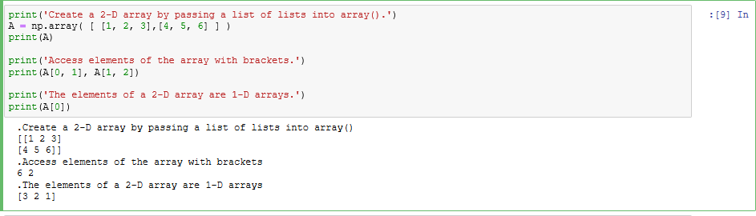
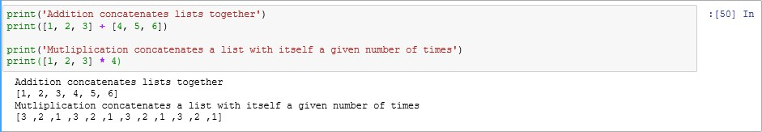
Lab 4: Data Preparation- NumPy Library
(like a list of lists), a 3-D array is a 1-D array of 2-D arrays (a list of lists of lists), and, more generally, an n-dimensional array is a 1-D array of (n - 1)-dimensional arrays (a list of lists of lists of lists...).
Each dimension is called an axis.
For a 2-D array, the 0-axis indexes the rows and the 1-axis indexes the columns. Elements are accessed using brackets and indices, with the axes separated by commas.
Exercise 1.1: Write a function that defines the following matrices as NumPy
arrays. 𝐴 = [
3 −1 4
]
2 4 −5 6
𝐵 = [−1 7 9 3 ], Return the matrix product
1 5 −9
3 2 −7 −2
AB. Hint: use help() function to see how np.dot() function can be used!
def dotArray(X,Y):
Z=np.dot(X,Y)
print(Z)
X = np.array([[3, -1, 4],[1, 5, -9]])
Y = np.array([[2, 4, -5 ,6],[-1, 7, 9, 3], [3, 2, -7, -2]])
dotArray(X,Y)
Exercise 1.2: Explore how np.ndarray() can be used! Give an example?
1.2. Basic Array Operations
NumPy arrays behave differently with respect to the binary arithmetic operators + and * than Pythonlists do. For lists, + concatenates two lists and * replicates a list by a scalar amount (strings also behave this way).

Slide 5
Lab 4: Data Preparation- NumPy Library
NumPy arrays act like mathematical vectors and matrices: + and * perform component-wise addition or multiplication.
Exercise 1.3: Assume X, Y matrices are given as follows:𝑋 = [3 −4 1] 𝑌 =
[5
2 3], what is the result of X+10? Y*4? X+Y? and X*Y? Write code down!
G = np.array([3, -4, 1])
H = np.array([5, 2, 3])
print(G+10)
print(H*4)
print(G+H)
print(G*H)
1.3. Working on Iris.csv file
[13 6 11]
[20 8 12]
[ 8 -2 4]
[15 -8 3]
1.4. Array Attributes
An ndarray object has several attributes, some of which are listed below.
Attribute | Description
dtype | The type of the elements in the array.
ndim | The number of axes (dimensions) of the array.
shape | A tuple of integers indicating the size in each dimension.
size | The total number of elements in the array.
Exercise 1.4: What is the output of A.ndim, A.shape, A.size? if A = np.array([[1, 2, 3],[4, 5, 6]])
2
(2, 3)
6
int32
Unlike native Python data structures, all elements of a NumPy array must be of the same data type. To change an existing array’s data type, use the array’s astype() method.
Exercise 1.5: Given A = np.array([[1, 2, 3],[4, 5, 6]]) what is the current data type of A?_
Change A type to float64
int32
Data Access
Array Slicing
Indexing for a 1-D NumPy array uses the slicing syntax x[start:stop:step]. If there is no colon, a single entry of that dimension is accessed. With a colon, a range of values is accessed. For multidimensional arrays, use a comma to separate slicing syntax for each axis.
What does x = np.arange(10) do?
Exercise 1.6: Using the code above, what is the output of x[3]?_
x[ : 4]
x[4 :]
x[4:8]
[0 1 2 3 4 5 6 7 8 9]
3
[0 1 2 3]
[4 5 6 7 8 9]
[ 4 5 6 7]

Slide 6
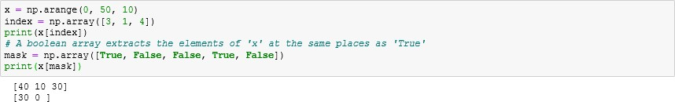
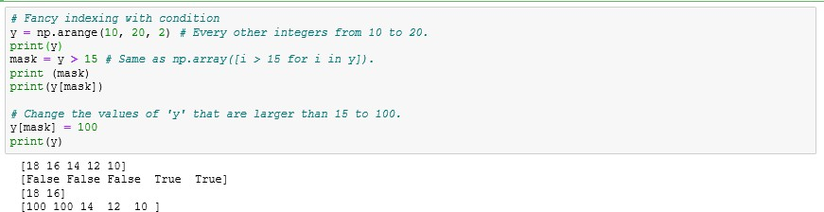
Lab 4: Data Preparation- NumPy Library
Exercise 1.7: Now, let x= np.array([[0,1,2,3,4],[5,6,7,8,9]]), what is the output of x[1, 2]?_ x[ : , 2 : ]? 7 [[2 3 4] [7 8 9]]
Note: Indexing and slicing operations return a view of the array. Changing a view of an array also changes the original array. In other words, arrays are mutable. To create a copy of an array, use np.copy() or the array’s copy() method. Changes to a copy of an array does not affect the original array, but copying an array uses more time and memory than getting a view.
1.5.2 Fancy Indexing
So-called fancy indexing is a second way to access or change the elements of an array. Instead of using slicing syntax, provide either an array of indices or an array of boolean values (called a mask) to extract specific elements.
Fancy indexing is especially useful for extracting or changing the values of an array that meet some sort of criterion. Use comparison operators like < and == to create masks.
Numerical Computing with NumPy
Universal Functions
A universal function is one that operates on an entire array element-wise. Universal functions are significantly more efficient than using a loop to operate individually on each element of an array.
Function | Description
abs() or absolute() | Calculate the absolute value element-wise.
exp() / log() | Exponential (ex) / natural log element-wise.
maximum() / minimum() | Element-wise maximum / minimum of two arrays.
sqrt() | The positive square-root, element-wise.
sin(), cos(), tan(), etc. | Element-wise trigonometric operations
1.6.2 Other Array Methods
The np.ndarray class itself has many useful methods for numerical computations.
Method | Return
all() | True if all elements evaluate to True.
any() | True if any elements evaluate to True.
argmax() | Index of the maximum value.

Slide 7
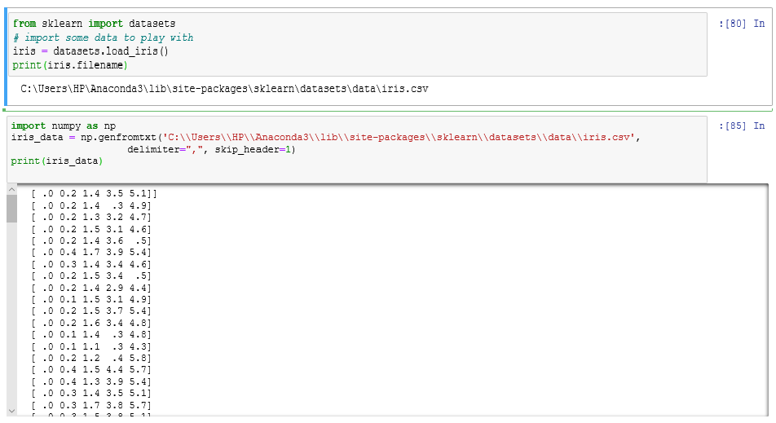
Lab 4: Data Preparation- NumPy Library
argmin() | Index of the minimum value.
argsort() | Indices that would sort the array.
clip() | restrict values in an array to fit within a given range
max() | The maximum element of the array.
mean() | The average value of the array.
min() | The minimum element of the array.
sort() | Return nothing; sort the array in-place.
std() | The standard deviation of the array.
sum() | The sum of the elements of the array.
var() | The variance of the array.
Demonstration of how the aforementioned method are used will present in section 2 of this lab.
Working on Iris.csv file
To work with iris.csv file, we have to ways:
load data set from https://archive.ics.uci.edu/ml/datasets/Iris
Use the code below to get the file path in your Anaconda environment. Then pass the path to
numpy.genfromtxt() function.
Note: Iris data set has the following attributes:
sepal length in cm
sepal width in cm
petal length in cm
petal width in cm
class:
-- Iris Setosa
-- Iris Versicolour
-- Iris Virginica
We can use the methods presented in Section 1.6.2 to show the descriptive features of the iris data set. The code below gives the mean value of the first attribute of iris data set.

Slide 8
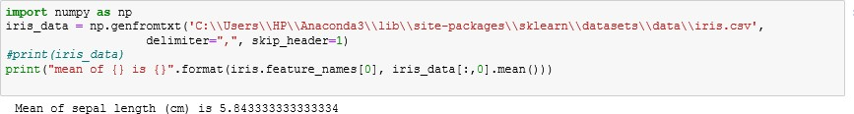
Lab 4: Data Preparation- NumPy Library
Exercise 2: Do the same thing for other attributes including the following methods (mean(), std(), var(), max(), and min())? Comment your observation!
Working with datasets using these methods can make the job a lot easier
Array slicing can also work with datasets
I was able to find the mean, standard deviation, minimum, maximum, And the variance using these methods
Upload YOUR ANSWER using your account in turnitin/ by email due to the beginning of next meeting
All the Best!!!

